Slide 1

Sinhgad Technical Education Society’s
SINHGAD COLLEGE OF ENGINEERING, Pune-41
Department of Information Technology
Project Review - II
Presented By
Asmita Nalawade
Shraddha Agre
Shubham Malpure
Swapnil Bhalerao
Guided By
Prof.J.S.Kulkarni

Slide 2
Project Title
Disease Prediction Using ML

Slide 3
Problem Statement
To develop and implement a model which takes symptoms as input. On the basis of that it predicts which disease the patient is having.
Input :
Symptoms in the form of text.
Output :
Report in the form of dashboard .
Health Status of User.

Slide 4
Scope
Model used to generate accurate prediction of disease.
Responsive test field to take symptoms from user
An informative dashboard to get proper status of user health.

Slide 5
Domain
Machine Learning
Deep Learning

Slide 6
Abstract
Now-a-days, people face various diseases due to the environmental condition and their living habits. So the prediction of disease at earlier stage becomes important task. But the accurate prediction on the basis of symptoms becomes too difficult for doctor. The correct prediction of disease is the most challenging task. To overcome this problem data mining plays an important role to predict the disease.
Medical science has large amount of data growth per year. Due to increase amount of data growth in medical and healthcare field the accurate analysis on medical data which has been benefits from early patient care. With the help of disease data, data mining finds hidden pattern information in the huge amount of medical data. We proposed general disease prediction based on symptoms of the patient.

Slide 7
Literature Survey
Sr.No | Author Name | Title | Description
1 | Akash C. Jamgade, Prof. S. D. Zade (Volume: 06 Issue: 05 | May 2019) | Disease Prediction Using Machine Learning | In this paper, we have combined the structure and unstructured data in healthcare fields that let us assess the risk of disease. The approach of the latent factor model for reconstructing the missing data in medical records which are collected from the hospital. And by using statistical knowledge, we could determine the major chronic diseases in a particular region and in particular community. To handle structured data, we consult hospital experts to know useful features.
2 | Yuvraj Nikhate, 2 M. V. Jonnalagedda,August 2020 | Survey on heart disease prediction using machine learning | Then use of machine learning algorithm for prediction of heart disease. From risk factors we have selected number of attributes and their minimum value for normal and diseased person. Values of the attributes more than the minimum value means you have a risk of heart disease. That means a person who have diabetes, smoking habit last 10 years, hypertension, chest pain, ST-T depression, older age more than 60 years, women with early menopause, over dirking, higher values of cholesterol more than 200mg/dl and person with blockage in heart vessels are more likely to be the heart disease person.
3 | Sarah Parisotb,1,∗ , Sofia Ira Ktenaa,1, Enzo Ferrantec , Matthew Leea , Ricardo Guerrerod,∗∗, Ben Glockera , Daniel Rueckerta | Disease Prediction using Graph Convolutional Networks: Application to Autism Spectrum Disorder and Alzheimer’s Disease | we present a thorough evaluation of a generic framework that leverages both imaging and non-imaging information and can be used for brain analysis in large populations. This framework exploits Graph Convolutional Networks (GCNs) and involves representing populations as a sparse graph, where its nodes are associated with imaging-based feature vectors, while phenotypic information is integrated as edge weights. The extensive evaluation explores the effect of each individual component of this framework on disease prediction performance and further compares it to different baselines.

Slide 8
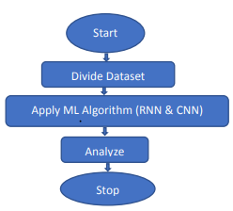
METHODOLOGY

Slide 9
Methodology
Step 1: Data collection and dataset preparation.
This will involve collection of medical information artifacts from various sources like hospitals, discharge slips of patients and from UCI repository then preprocessing is applied on dataset which will remove all the unnecessary data and extract important features from data.
Step 2: Developing a probabilistic modeling and deep learning approach (CNN) for Disease Prediction.
In this step probabilistic modeling and deep learning approach based on CNN is to be developed it will run effectively on extensive databases of healthcare. And generate decision tree also it can deal with a huge number of information variables without variable deletion.
Step 3: Training and experimentation on datasets.
The Disease Prediction model will be trained on the dataset of diseases to do the prediction accurately
Step 4: Deployment and analysis on real life scenario.
The trained and tested prediction model will be deployed in a real-life scenario made by the human experts & will be leveraged for further improvement in the methodology and will follow the above architecture.

Slide 10
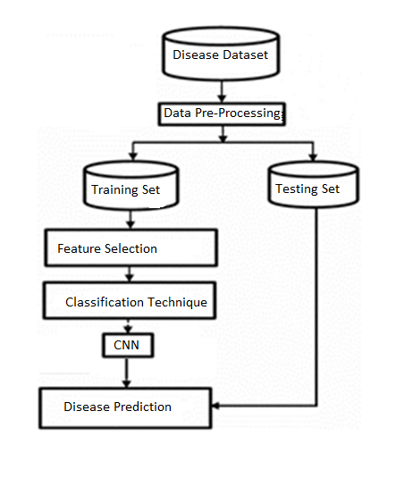
Technology to be used :
Tools such as Anaconda Python, and
python libraries will be utilized for this
process.

Slide 11
Algorithms
Python based Deep Learning libraries will be exploited for the development and experimentation of the project. CNN is used for the classification.
Convolutional neural network (CNN)
Step 1: The dataset is converted into the vector form.
Step 2: Then word embedding is carried out which adopt zero values to fill the data. The output of word embedding is convolutional layer.
Step 3: This Convolutional layer taken as input to pooling layer and we perform max pooling operation on convolutional layer.
Step 4: In Max pooling the dataset is convert into fixed length vector form. Pooling layer is connected with the full connected neural network.
Step 5: The full connection layer is connected to the classifier that is softmax classifier.

Slide 12
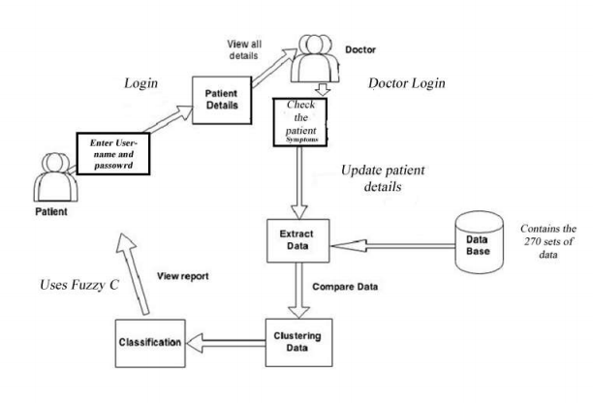
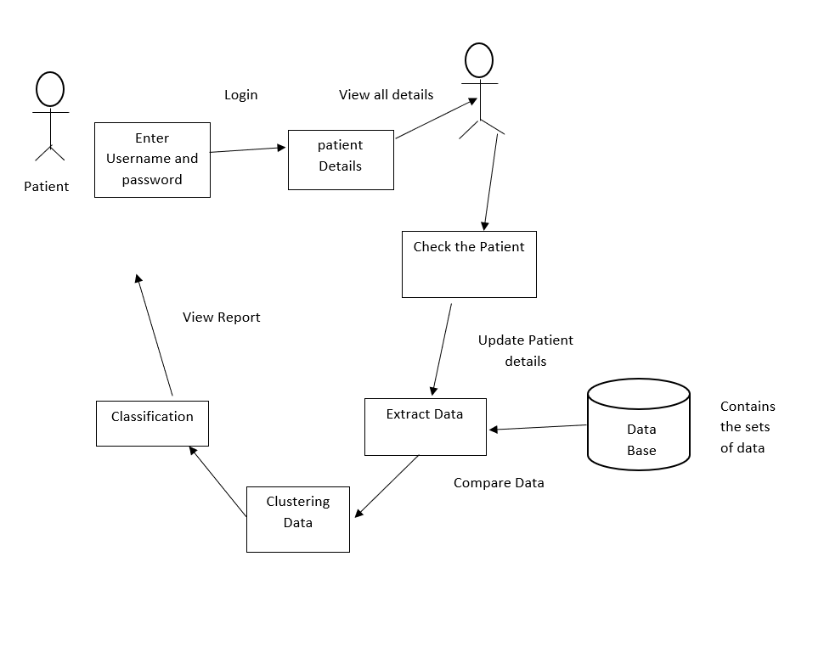
ARCHITECTURE DIAGRAM

Slide 13
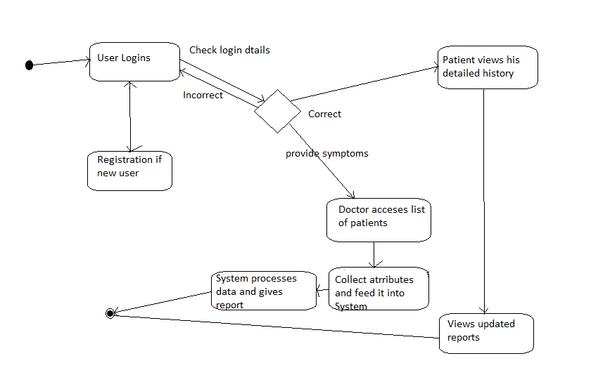
ACTIVITY DIAGRAM

Slide 14
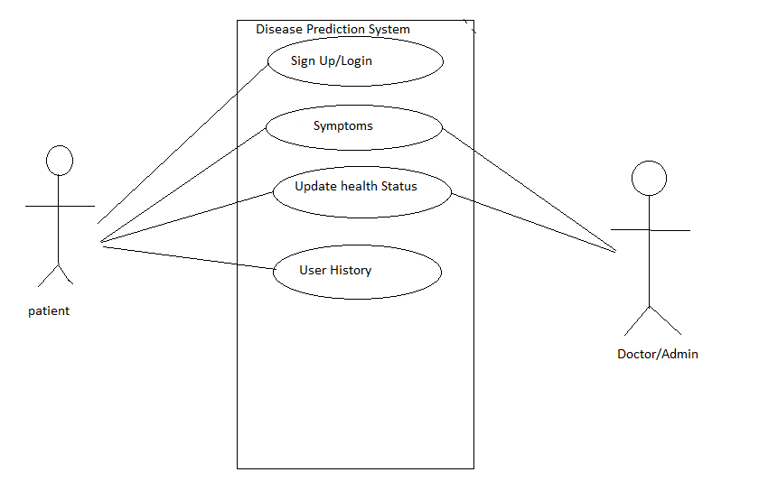
USE CASE DIAGRAM

Slide 15
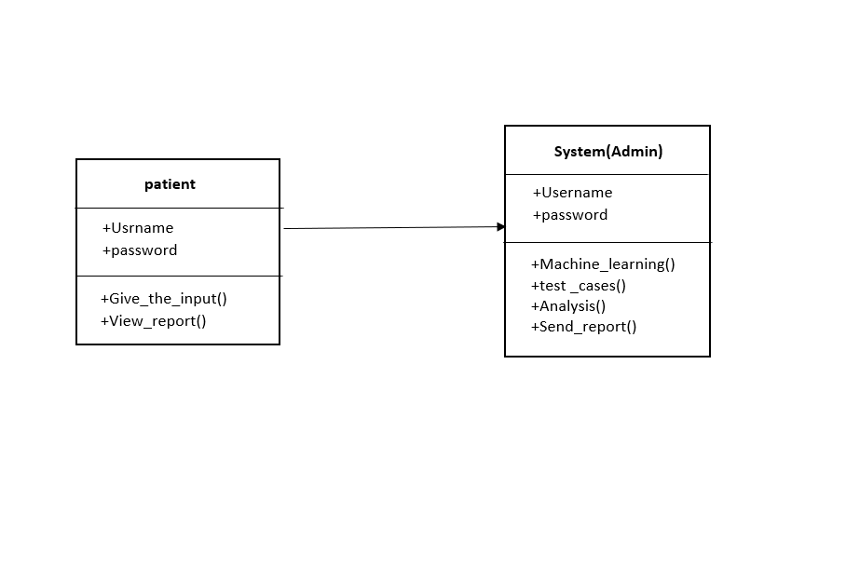
CLASS DIAGRAM

Slide 16
PROJECT CONTENT
List Of Modules for Disease Prediction Are:
User module
Doctor module
Software:
Software and Hardware Requirements Training will be conducted on NVIDIA GPUs for training a probabilistic modeling and deep learning approach for diseases prediction. We can use medical hardware devices for capturing the real data or test the results on real-time data.

Slide 17
User Module
With the datasets already acquired from the UCI Machine learning repository, we can now proceed with collecting the details of the patients.
Data like the Patient's Name, Blood Group, Address, Phone number, Sex, Weight, Height are collected from the patients themselves to help with the creation of an individual user account.
Already registered user can directly start accessing the system with the help of the user id and password provided.

Slide 18
Doctor Module
Doctor views all patient details and their Medical History.
Doctor with the help of the medical records, punch in the value of the attributes which is fed into FCM for clustering purposes.
The attributes used are given below Age, Sex, Chest Pain, Rest BP, Cholesterol, Sugar, ECG, Max heart range, Angina, Old peak, Sis Lope, Vessels, Thalassemia.
The result is a screen that displays the chance of a person having any disease.
The system then produces a list of suggestions for the person with the given attributes

Slide 19
References
[1] Study of machine learning algorithms for special disease prediction using principal of component analysis December 2019.
Conference: 2016 International Conference on Global Trends in Signal Processing, Information Computing and Communication (ICGTSPICC)
[2] Mr. Chala Beyene, Prof. Pooja Kamat, “Survey on Prediction and Analysis the Occurrence of Heart Disease Using Data Mining Techniques”, International Journal of Pure and Applied Mathematics, 2018.
[3] “Dmitry Ignatov and Andrey Ignatov. Decision Stream: Cultivating Deep Decision Trees”, 3 Sep 2017 IEEE”.
[4] S. Patel and H. Patel, “Survey of data mining techniques used in healthcare domain,” Int. J. of Inform. Sci. and Tech., Vol. 6, pp. 53-60,March 2016

Slide 20
Thank You!!!

